Slide 1

Real Estate Data Analysis
Melissa Djohan
Limei Hou
Indira Poovambur

Slide 2
Core Message:
We wanted to find out if our randomly picked three cities (Austin, Texas; Cupertino, California; and Syracuse, Utah) would have any sort of correlation.
The main question we wanted to answer is:
Is there a significant difference in average yearly market value between the cities?

Slide 3


Slide 4
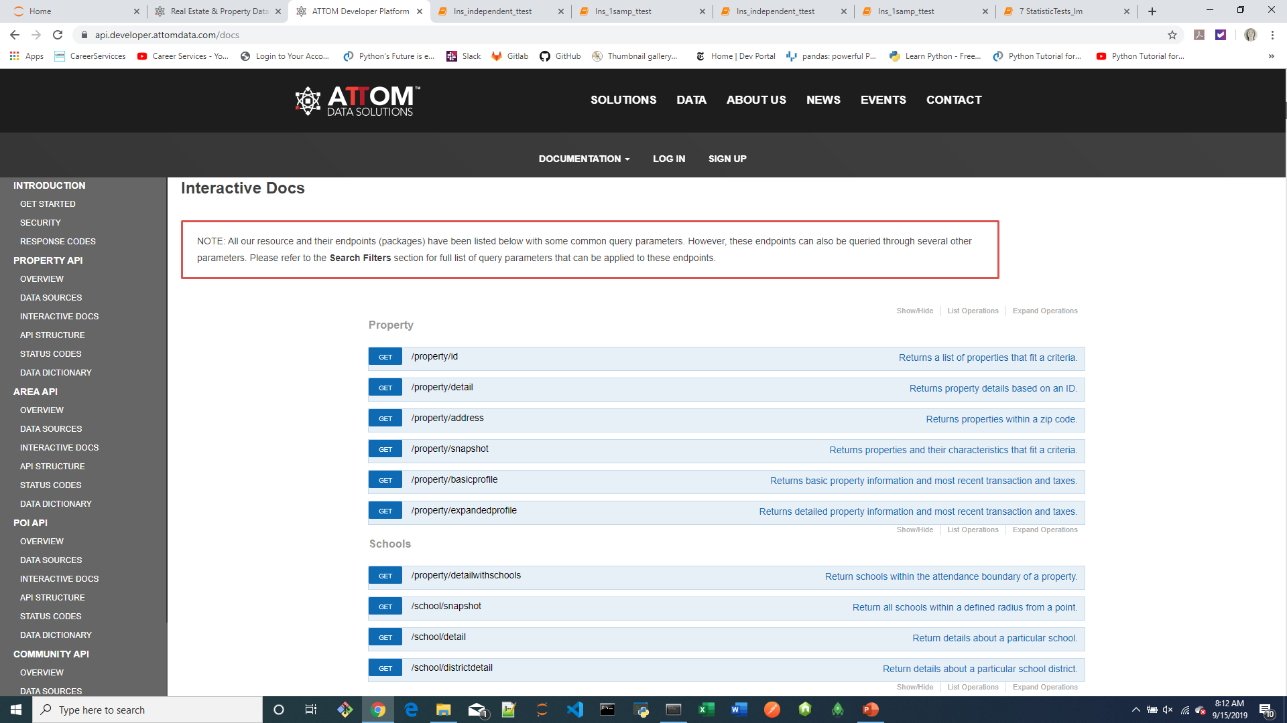
Study API End Points: Interactive Docs

Slide 5
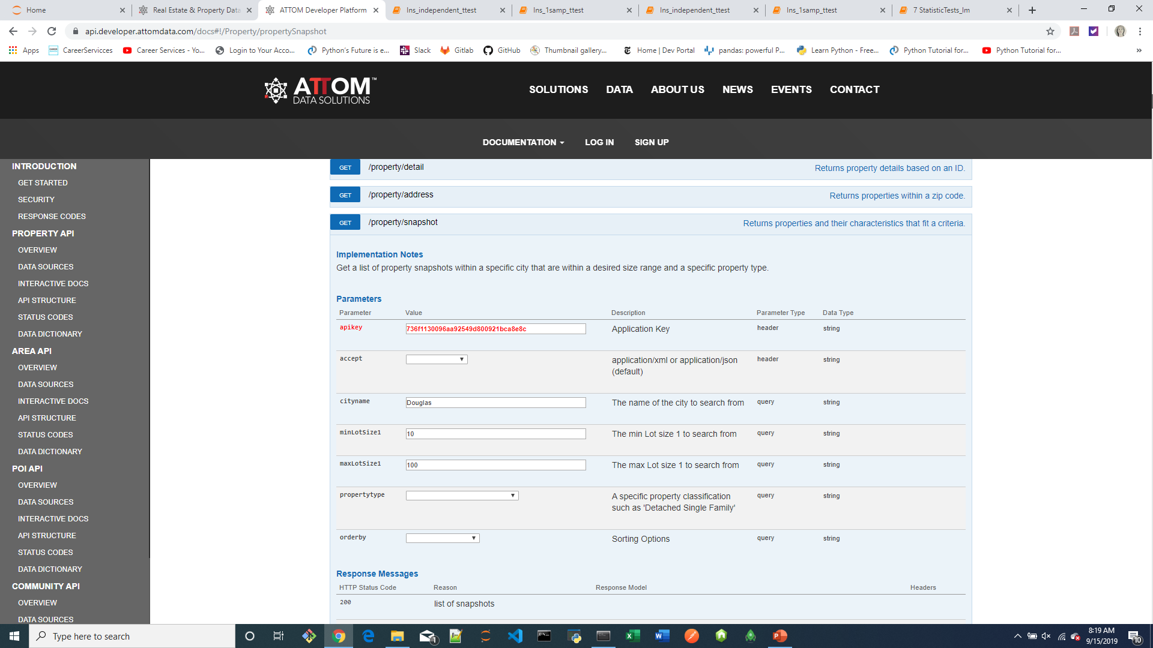
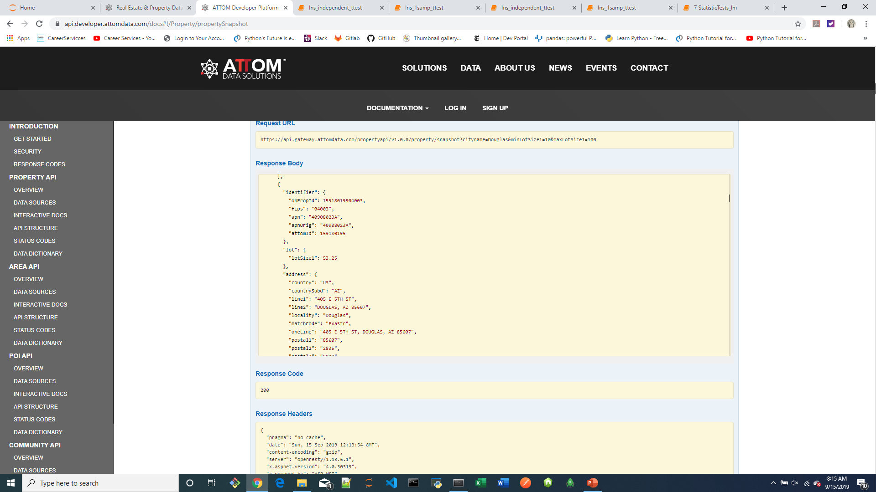
Study API End Points: Interactive Docs

Slide 6
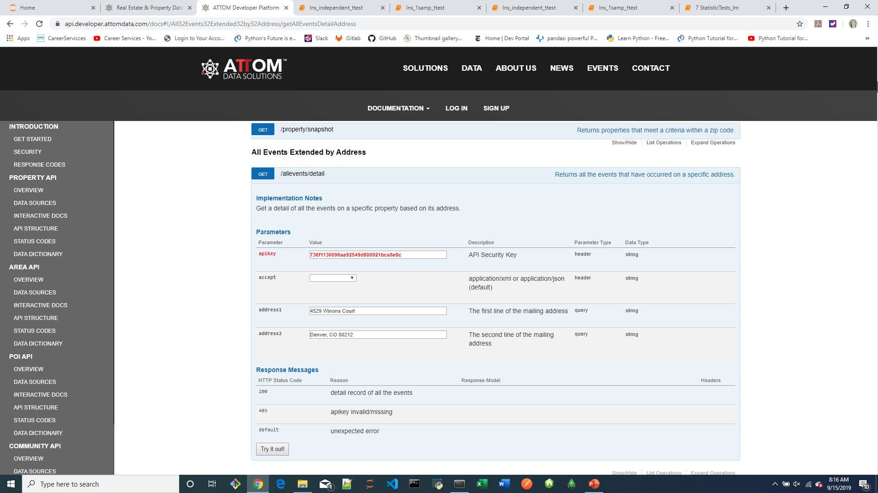
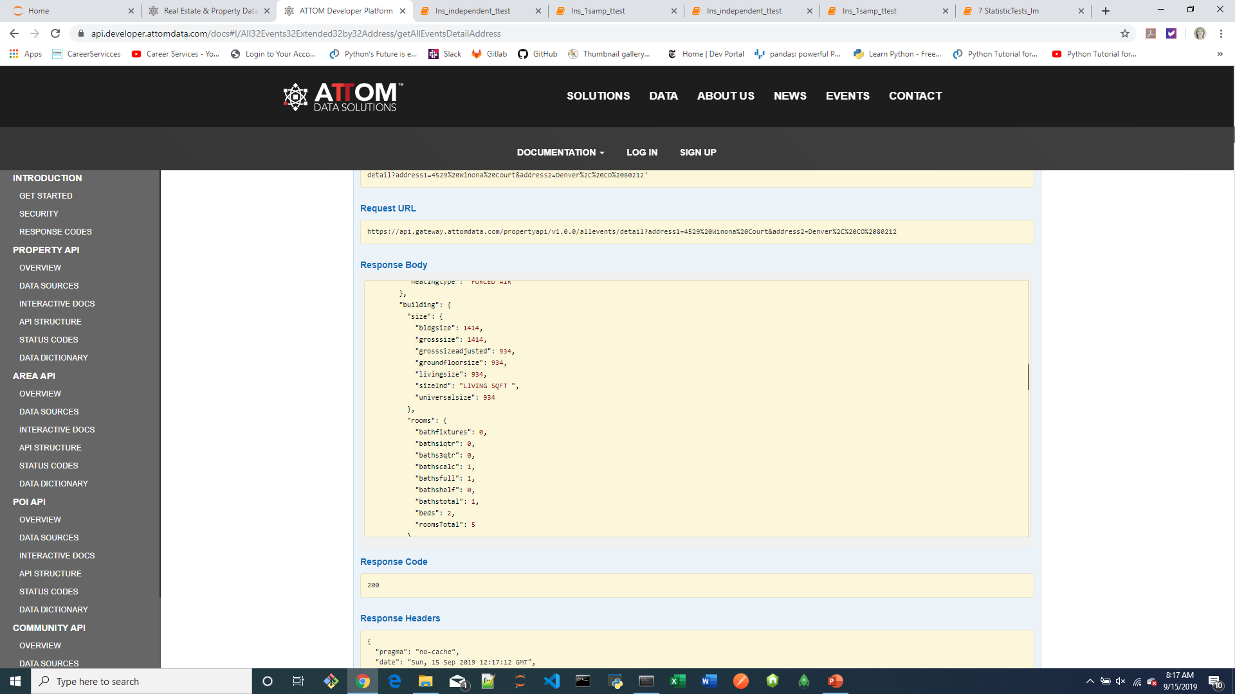
Study API End Points: Interactive Docs

Slide 7
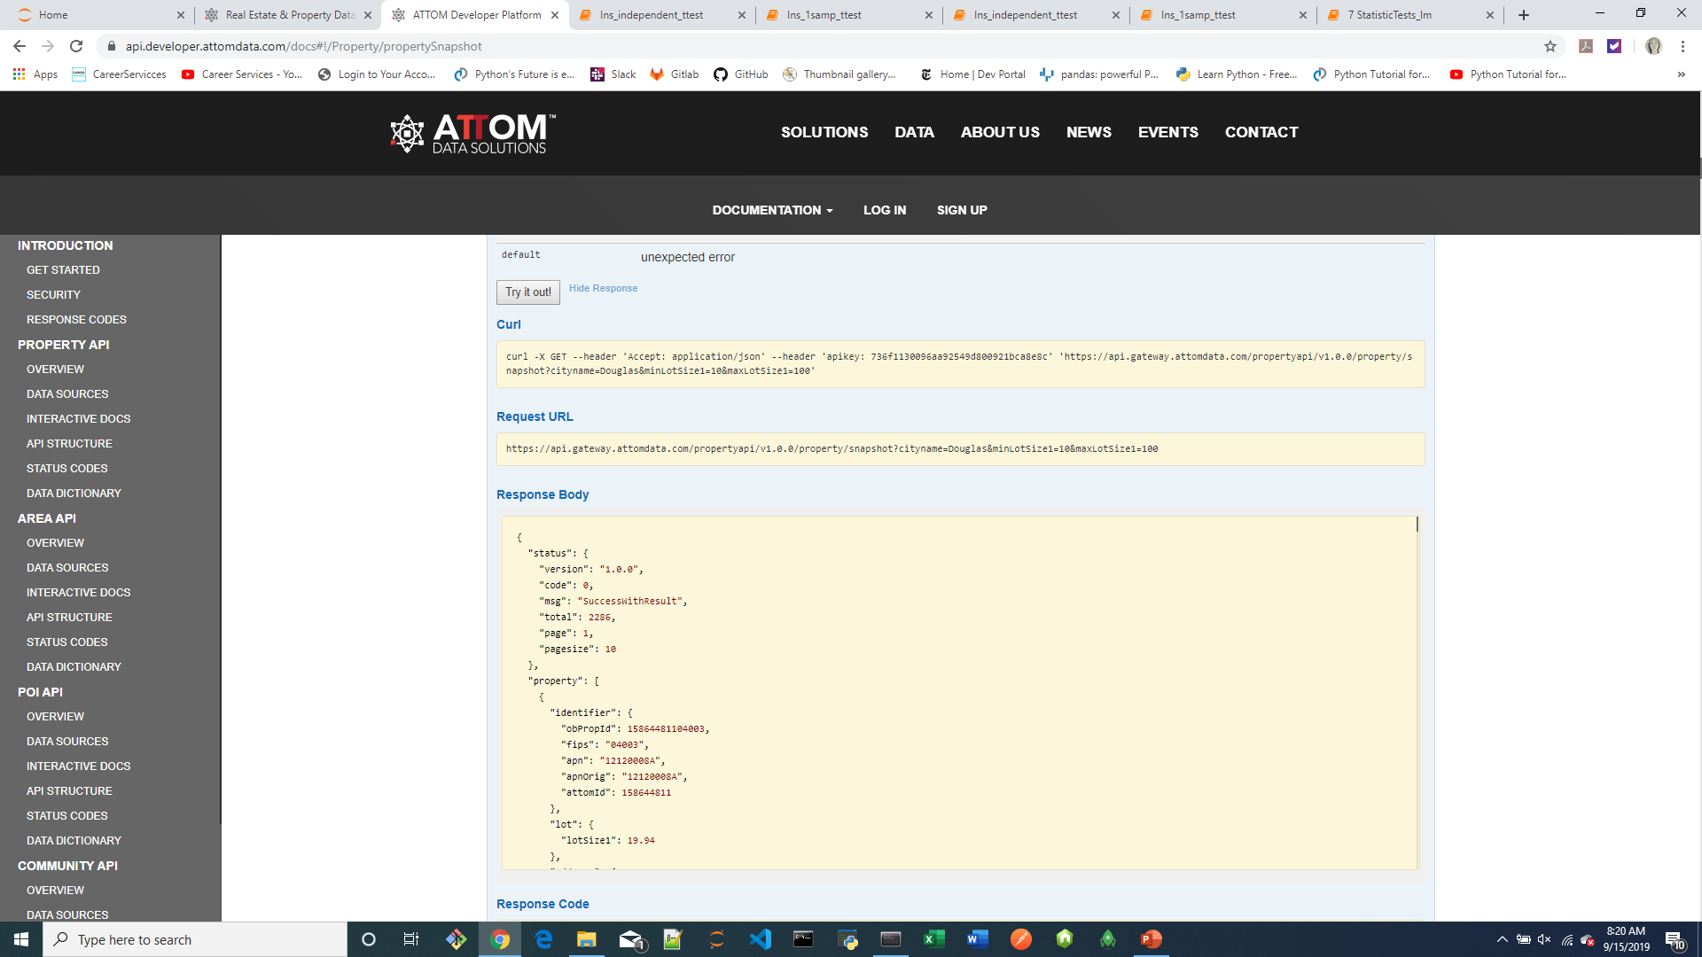
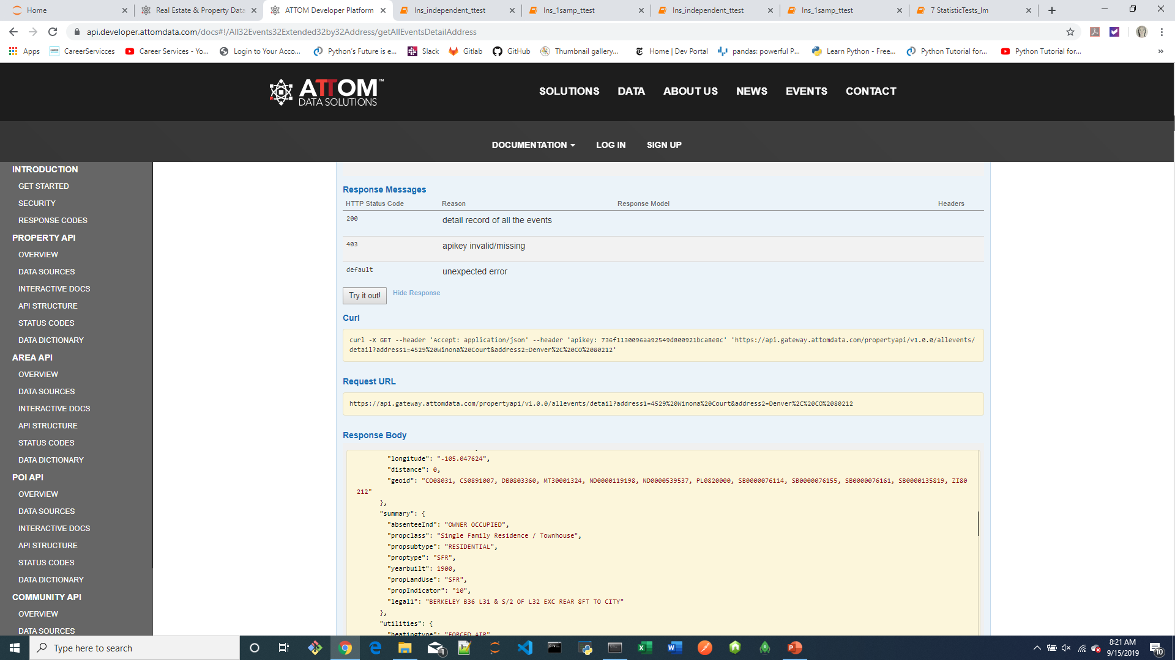
Study API End Points: Interactive Docs

Slide 8
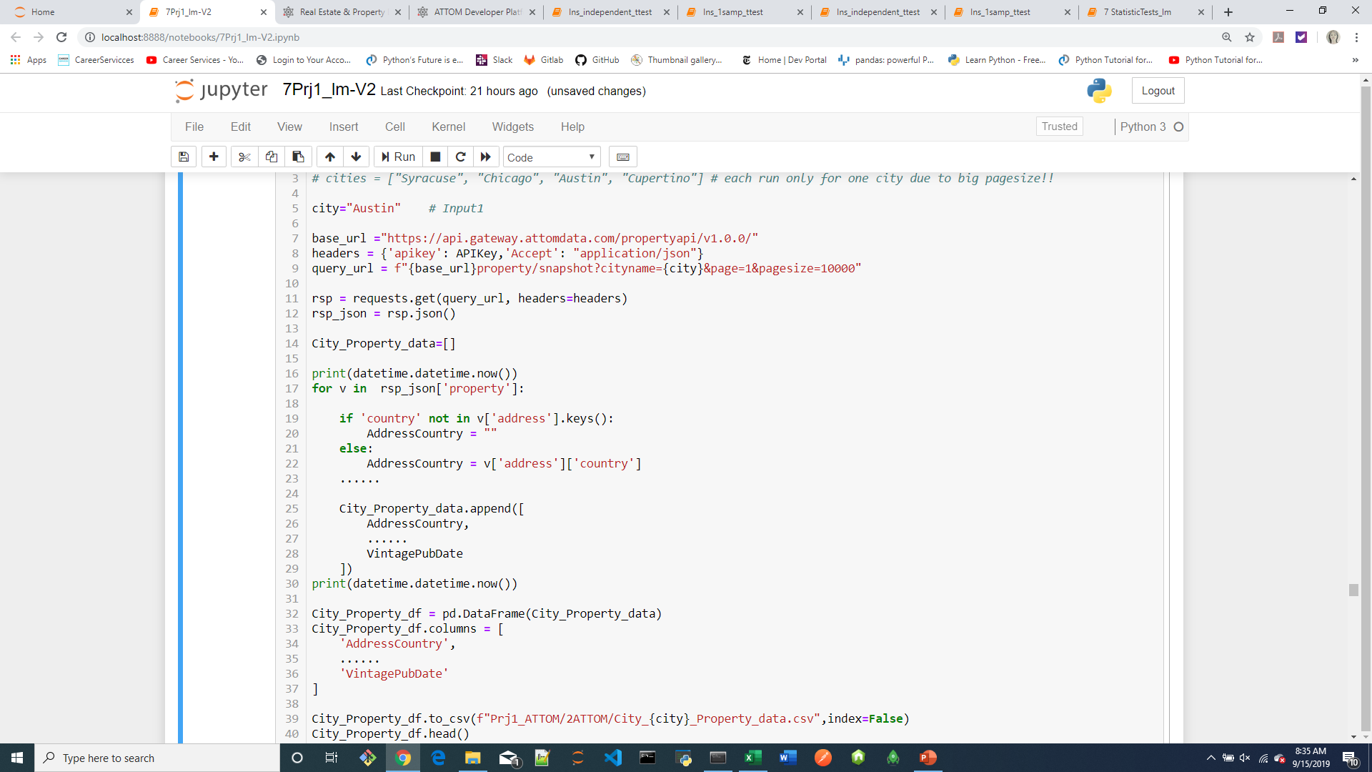

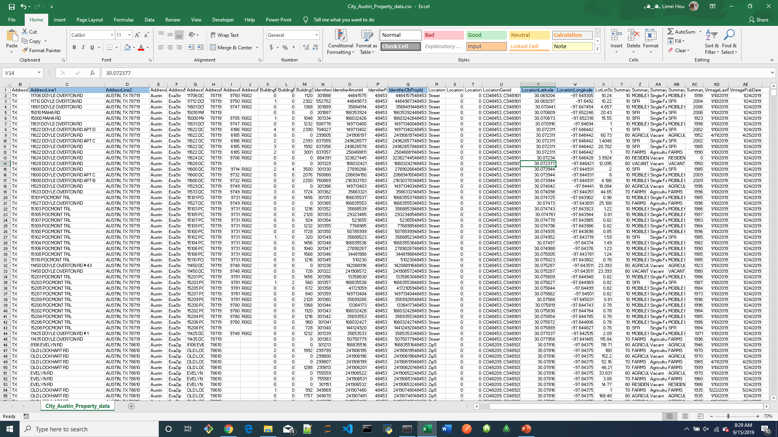
1st API Call

Slide 9
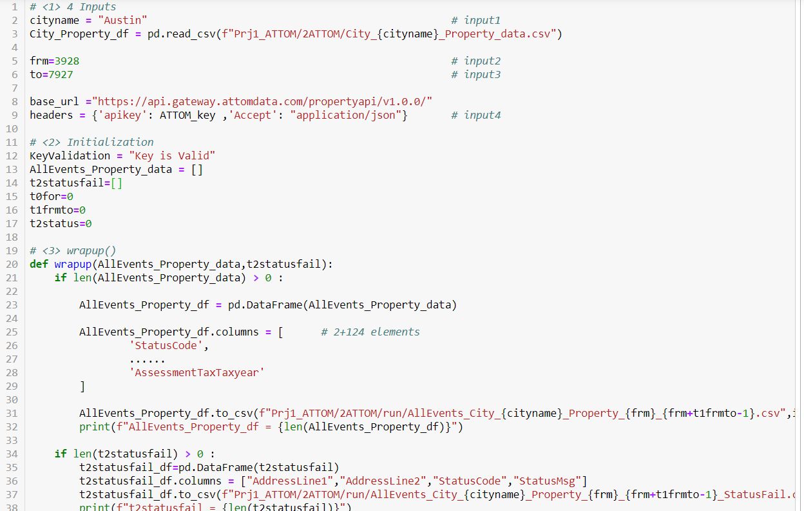
2nd API Call
# 200: {'status':{"code":"", "msg":"", ...}, {'property':[{},{},{} ]} }
# 403: {'Response': {'status':{"code":"", "msg":"", ...} } }

Slide 10
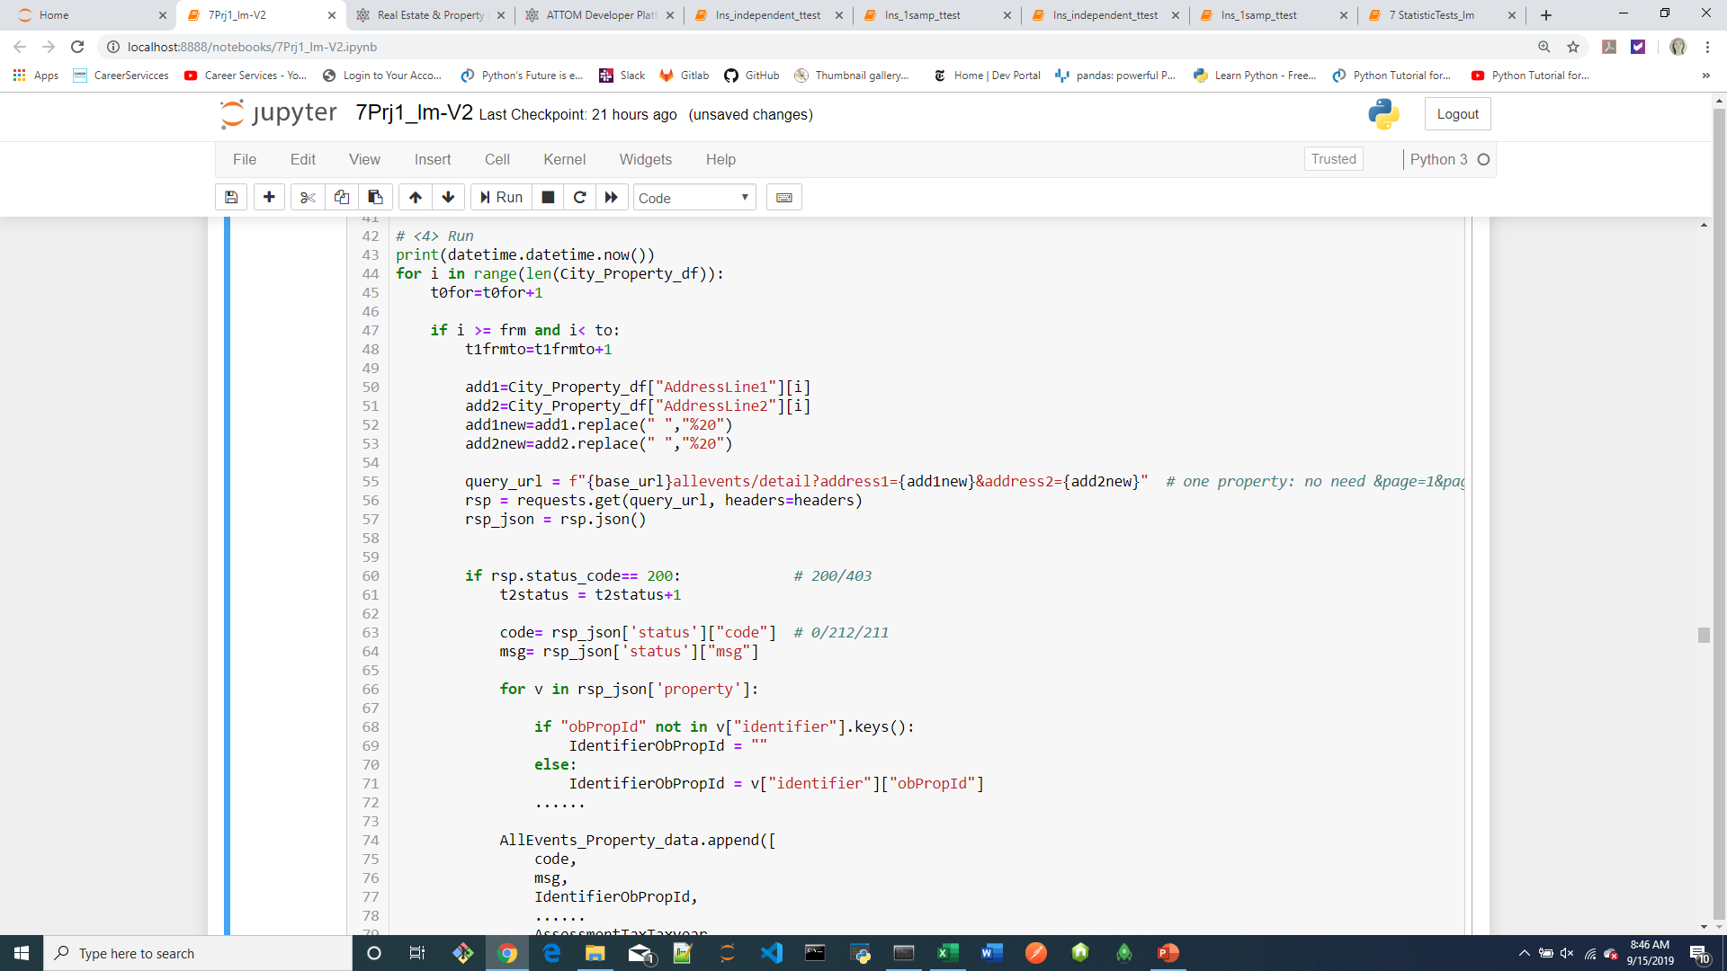
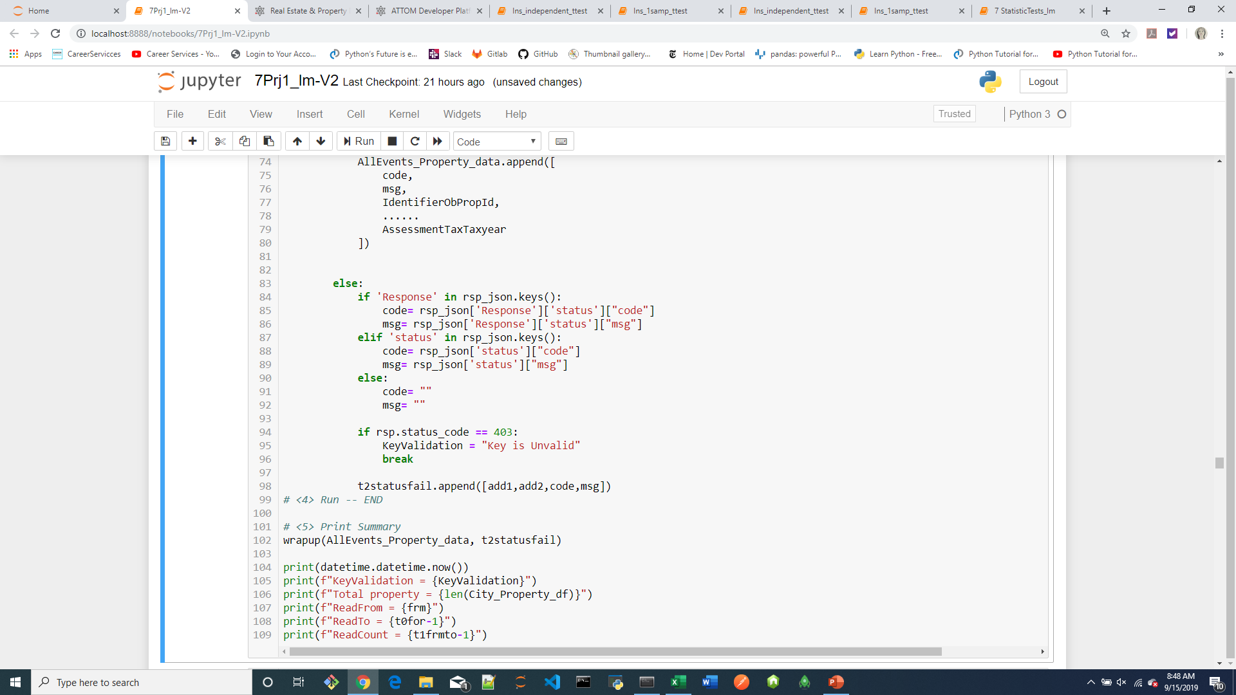
2nd API Call

Slide 11
Data Exploration and Clean-up Process:
Dropped the data frame from 124 to 12 columns
Renamed columns to more meaningful names
In some cases sorted the columns
In some cases converted the data type to facilitate sorting of the column

Slide 12
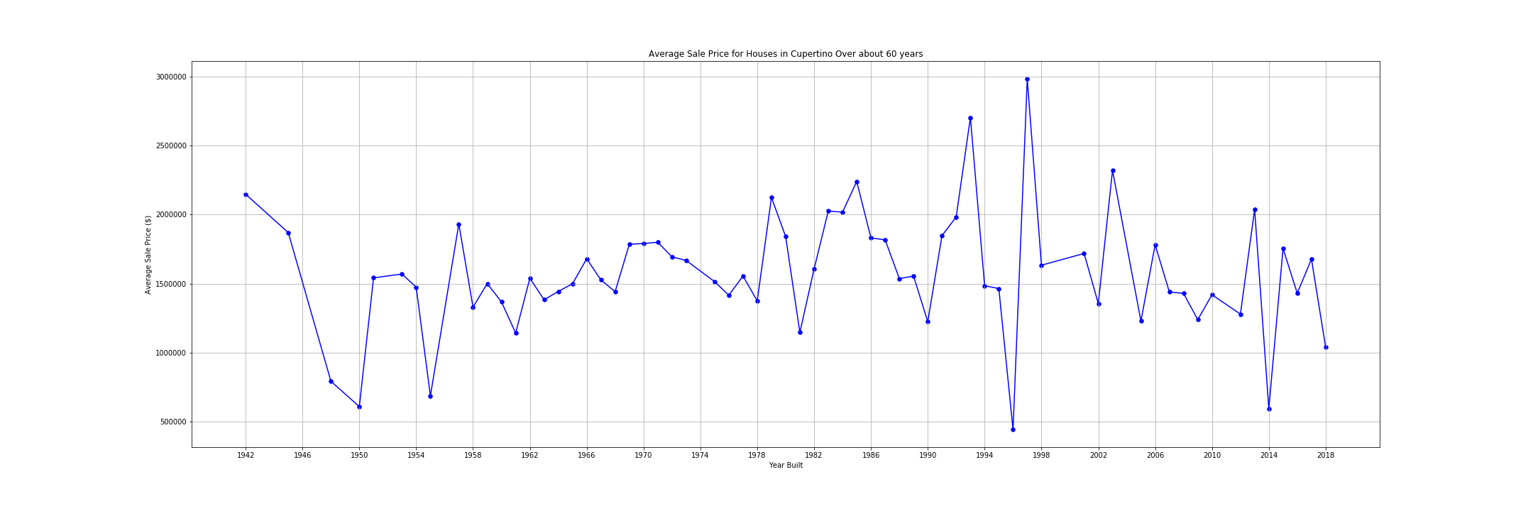
Are the houses selling?
Cupertino
Avg price between 1 to 2 M, drop from their 3 M.

Slide 13
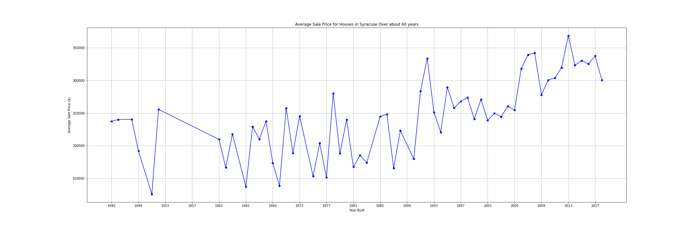
Are the houses selling? (cont.)
Syracuse
The market looks good here, the average price has gone up and is at a all time high.

Slide 14
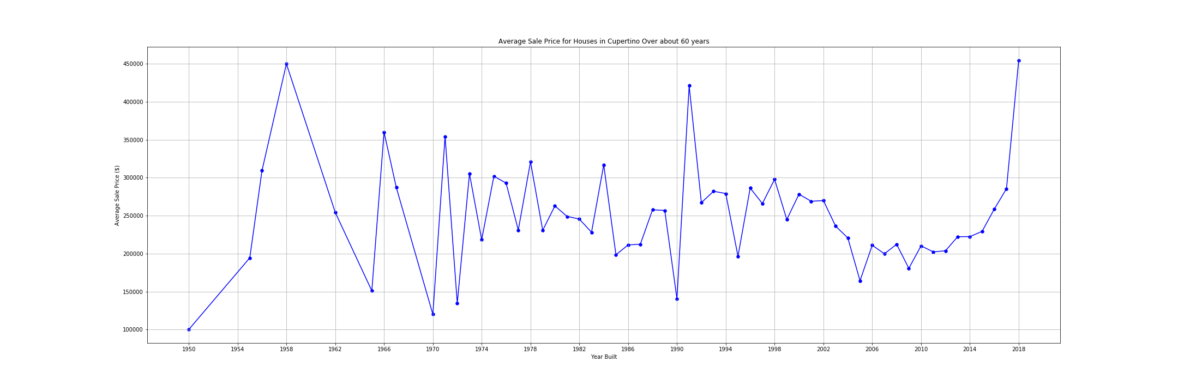
Are the houses selling? (cont.)
Austin
The market looks good here, the average price has gone up and is at a all time high at 450K.

Slide 15
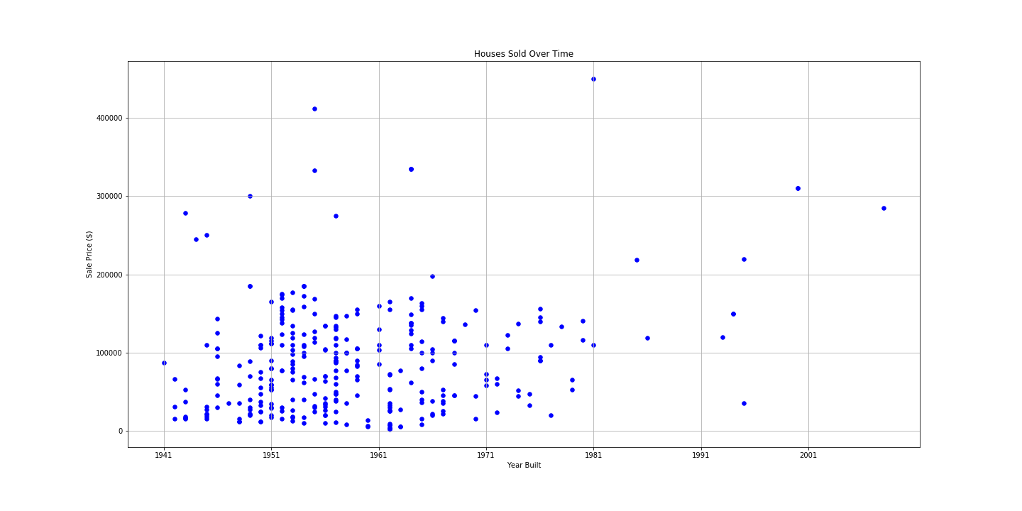
Are the houses selling (contd.)
Chicago
No. Overall a bad housing market, so no further analysis conducted.

Slide 16
Other questions we wanted to answer in the process:
What are other factors that go into the market value of a home?
Bedroom count?
Bathroom count?

Slide 17
What sold the most?
So, based on room count, bedroom count and bath count here’s our findings:
Cupertino: 8 rooms, 3 bedrooms,2 baths.
Syracuse: 6 rooms, 2 bedrooms, 2 baths.
Austin: No data room on room count or bedroom count, 2 baths.

Slide 18
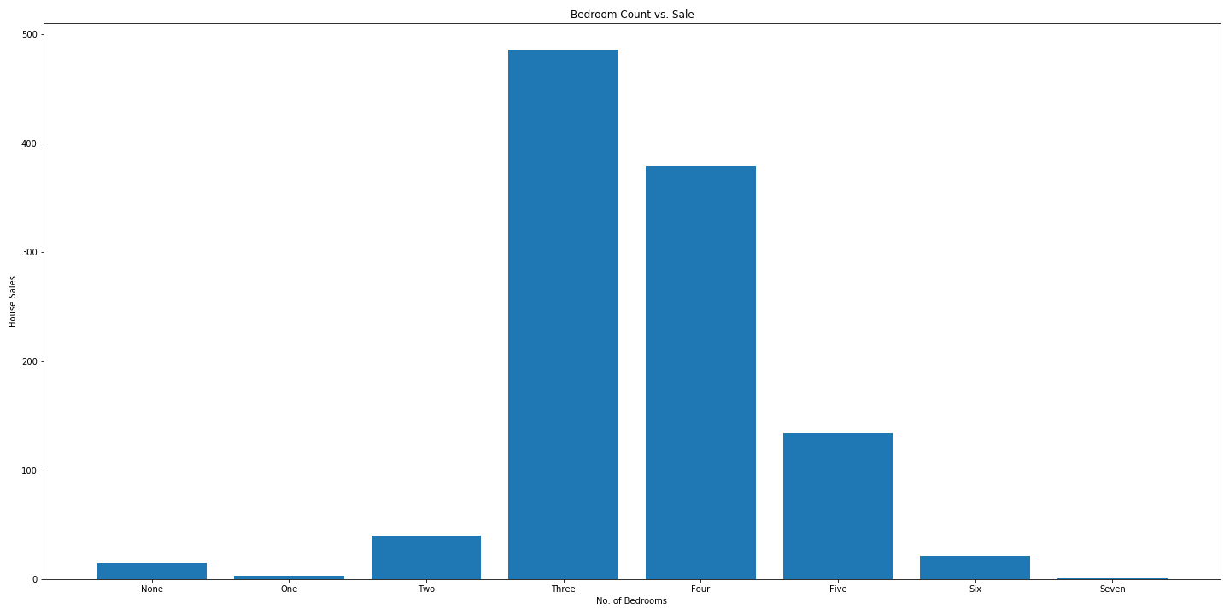
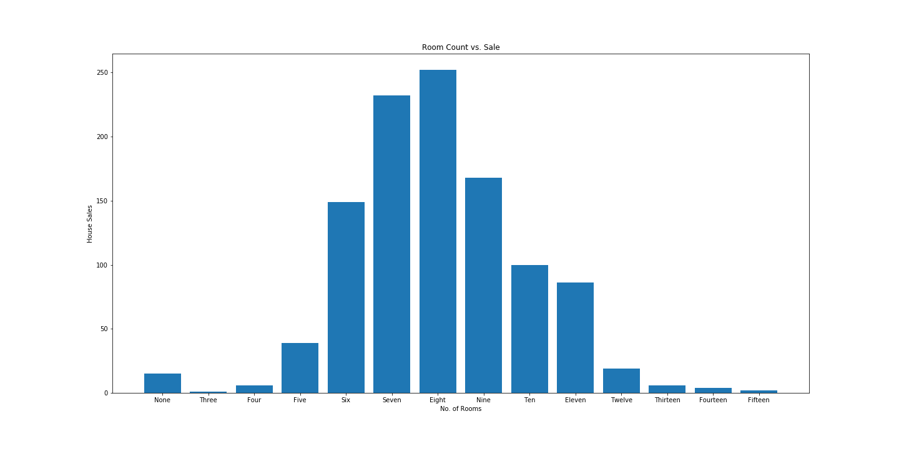
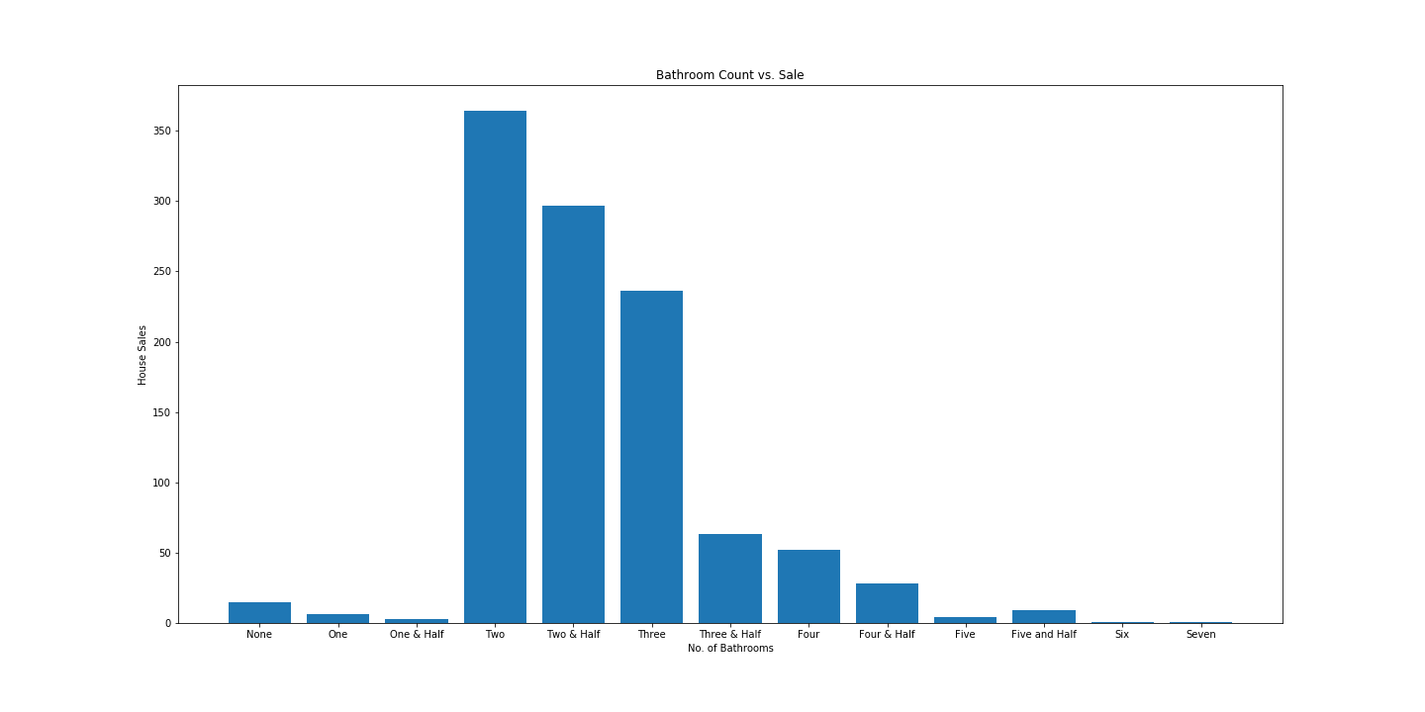
Cupertino

Slide 19
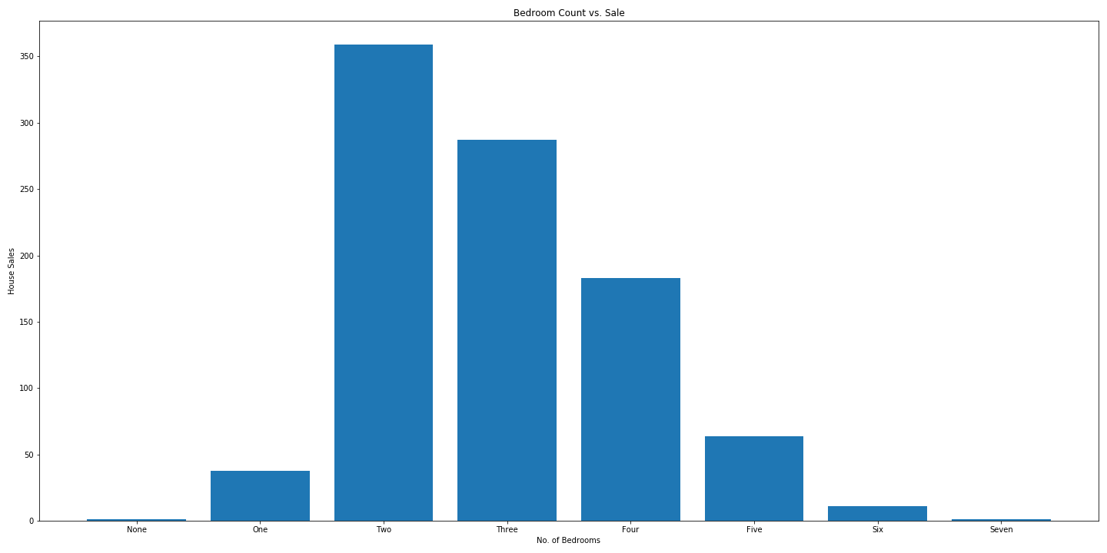
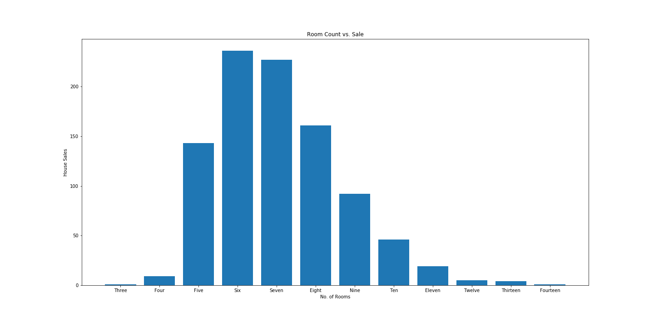
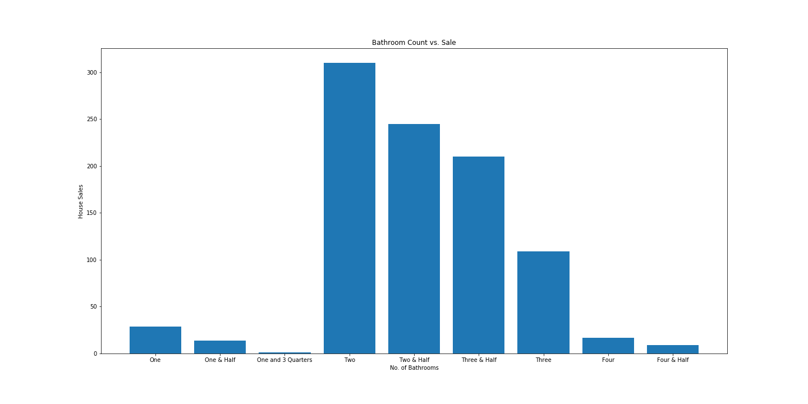
Syracuse

Slide 20
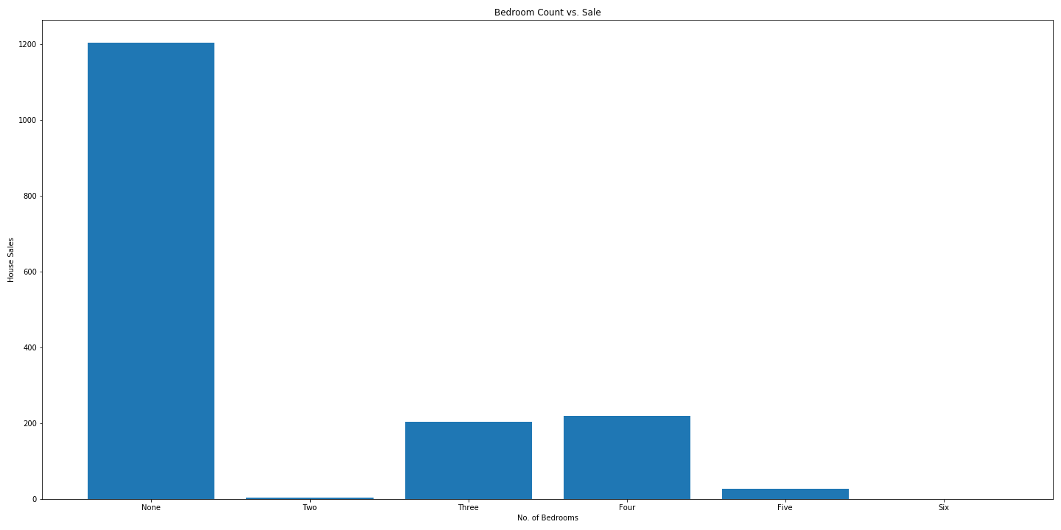
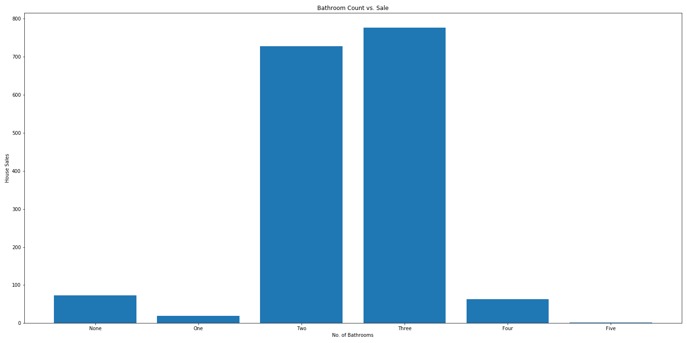
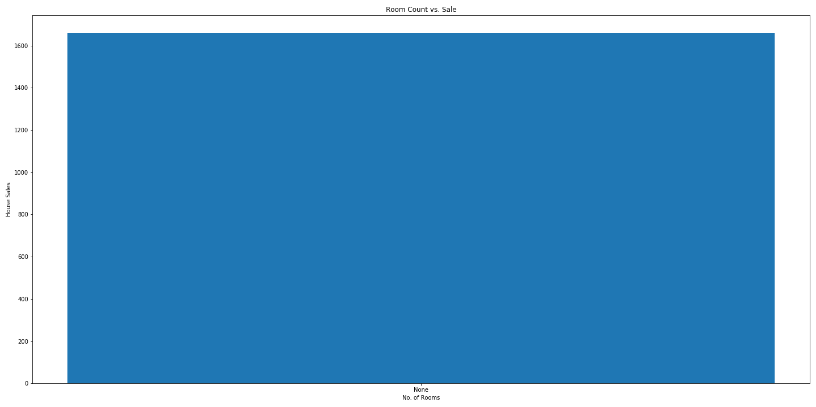
Austin

Slide 21
The Story:
Austin and Syracuse are top markets. People generally prefer mid size homes with 2 baths.
Is America ready for live work and play community?
…Further analysis is required.

Slide 22
H_{o}: Aus = cup = syr H_{A}: The mean mkt price is different for at least one city

Slide 23
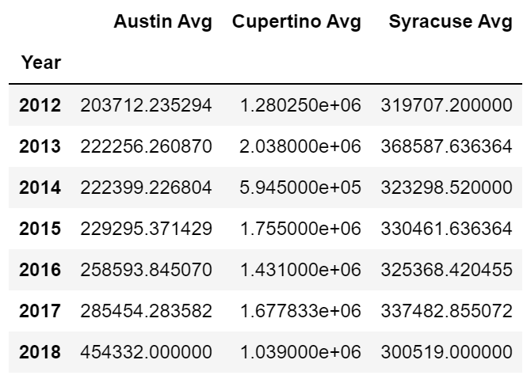
So we ask again… Is there a significant difference in average yearly market value between the three cities?
After saving the data from all three notebooks into a separate folder, then merging the data. We then made a new dataframe with all of the average sale price data over time of the three cities.

Slide 24

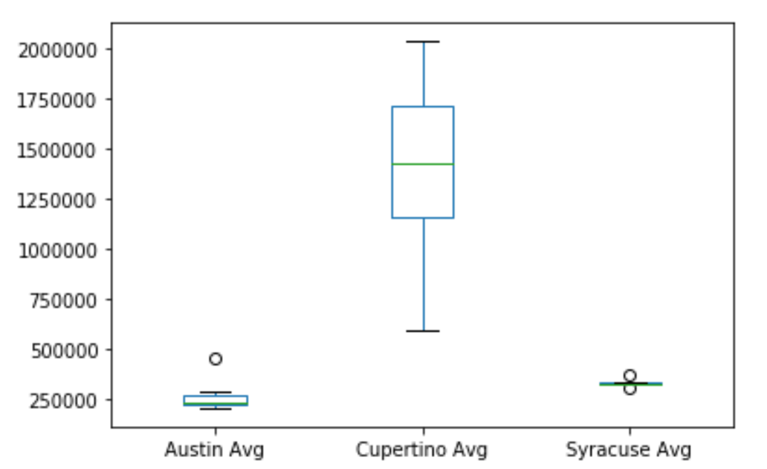
Next we plotted that data into a box plot, to visually show us what the differences of the averages would look like side by side.

Slide 25
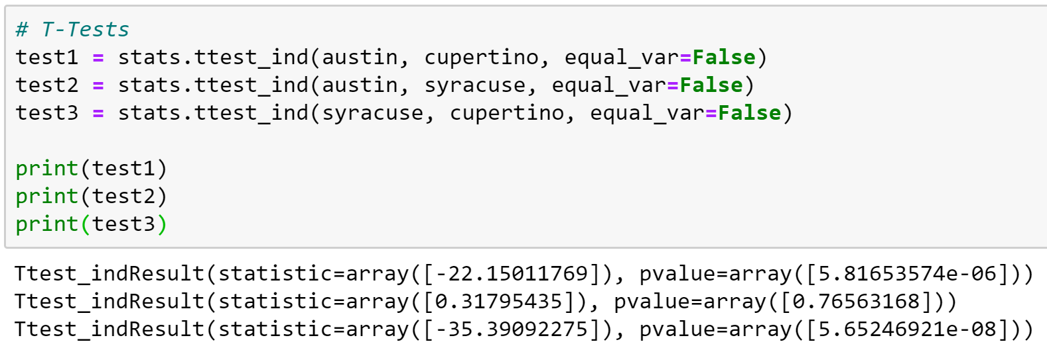
Finally
We ran t-tests to check each and see if any of them are similar or significantly different

Slide 26
In conclusion:
The results show that there is not a significant difference between Austin and Syracuse… they are similar markets.
1
The results that Cupertino is significantly different than both Syracuse and Austin.
2

Slide 27
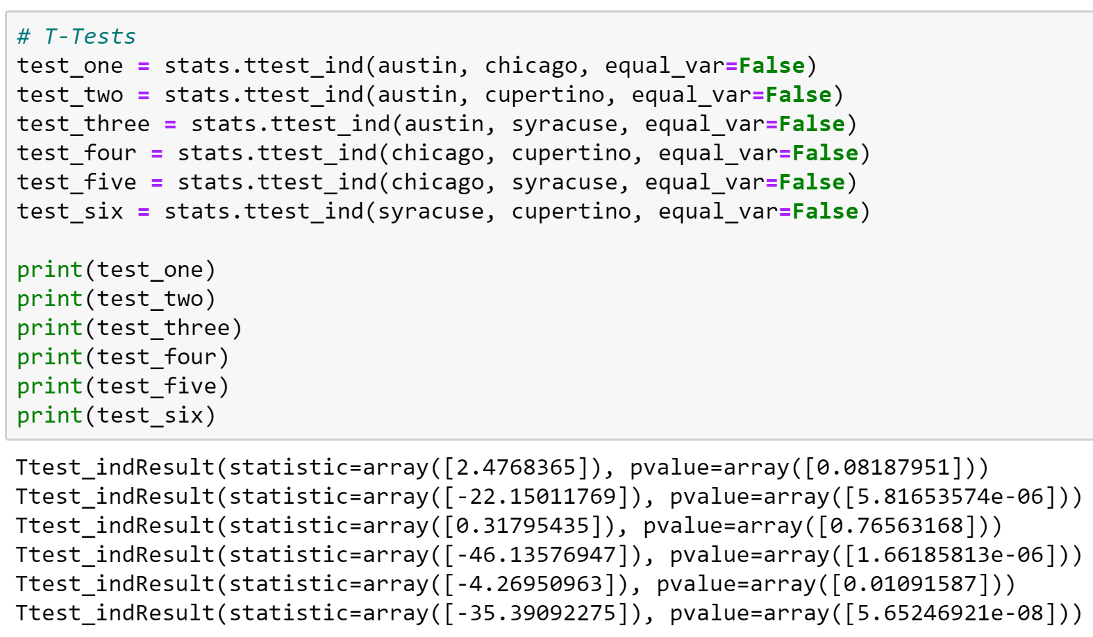
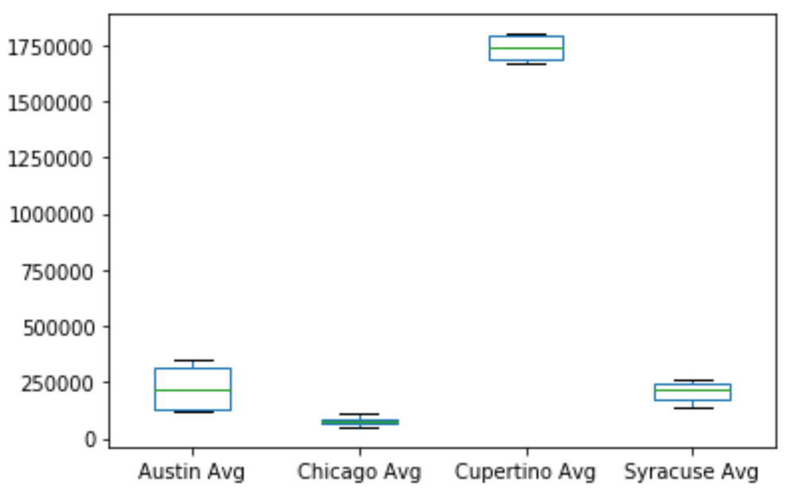
Now, adding Chicago, does our outcome change?

